Slide 1
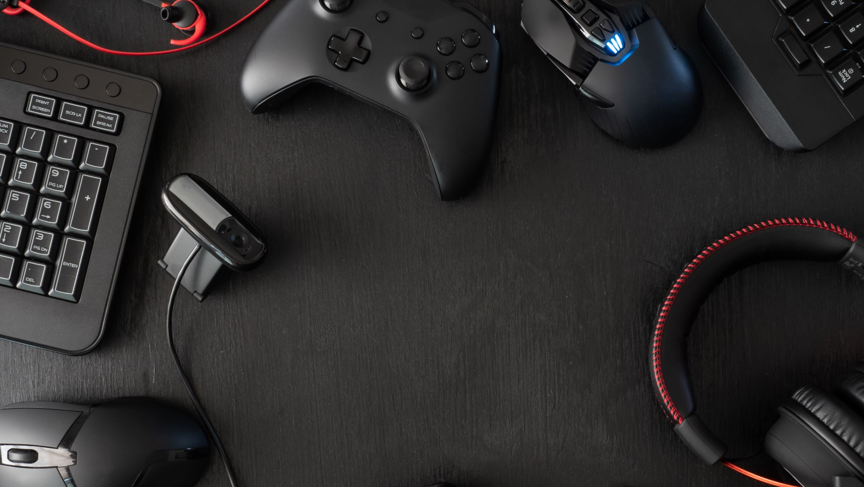
New Ways to Play: A Study in Alternative Game Controllers

Slide 2
Overview
First Person Shooter
Playable on PC
Custom Controller (Pi Pico W H & MPU6050)
Study on how alternative controllers effect gameplay and immersion.
Address the accessibility and ethics

Slide 3
Prototype Parts
BreadBoard
Jumper Wires
Pi Pico W H
MPU6050 (Accelerometer & Gyroscope Module)
Button

Slide 4
State of game
Main Menu
2 Scenes (Training Room & Match Room)
Health Bar with Animation
Gun Model (from Sketchfab referencedin ReadMe)
Custom Textures
Player Shoot
StateMachine Enemies for patrol, chase and attack
Custom Model for Enemy

Slide 5
State of Prototype and next stages
Current prototype of the controller works fine still some polish needed for the motion tracking when looking around it can go off centre and the player needs to angle the controller which can be weird.
Changed from Serial Port to HID so it is easier to test on other computers makes it easier to use.
Plug USB in and works fine controlling the mouse with hand motion left/right and up/down. Works in game and the button can be used to interact with stuff like shooting or pressing buttons.
Plan to switch to a perfboard for a more finalised form and 3D printing a case where it will be stationed in to look better and more practical to use. Improving the code so it is more reactive and does not have any delay and more responsive.

Slide 6
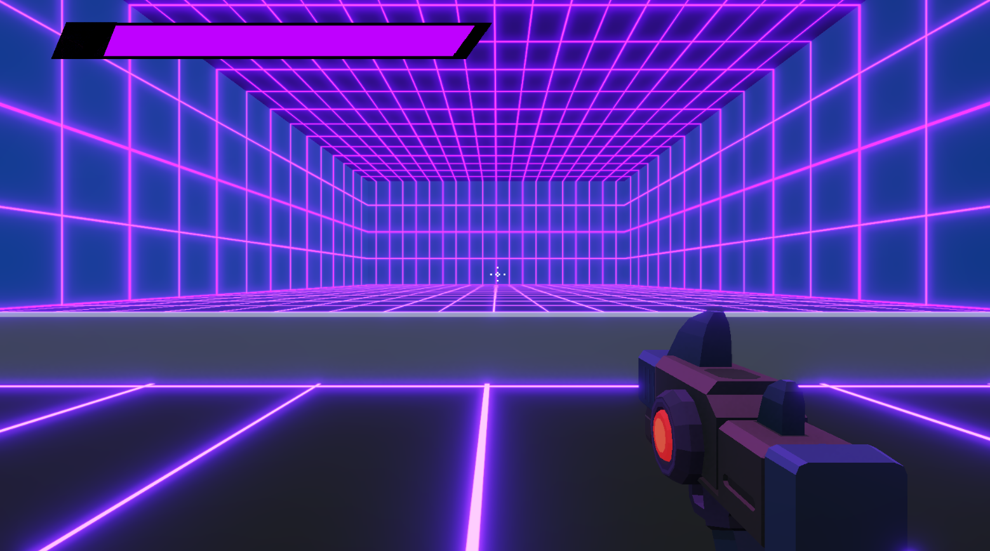
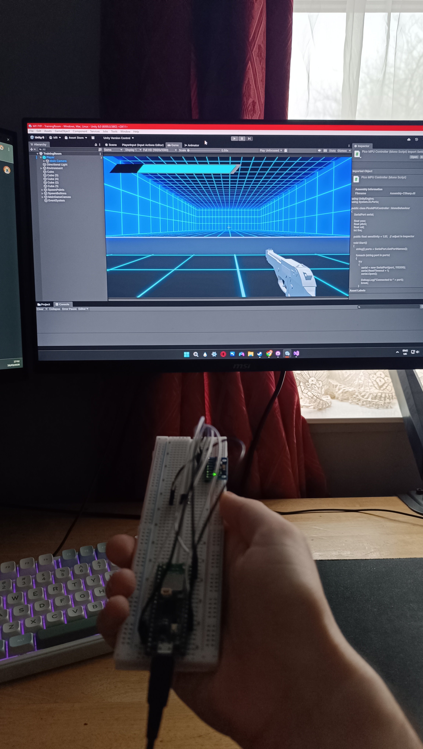
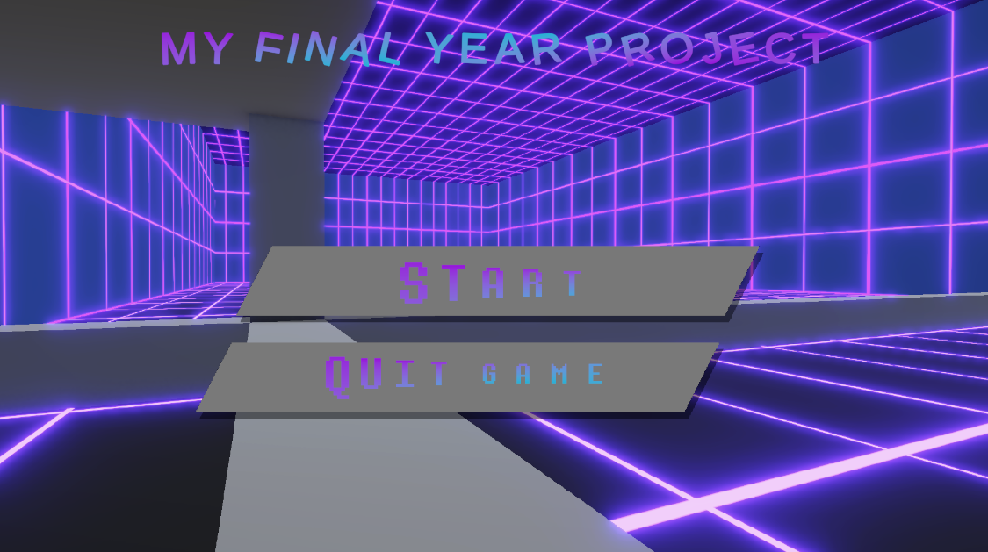
Images

Slide 7
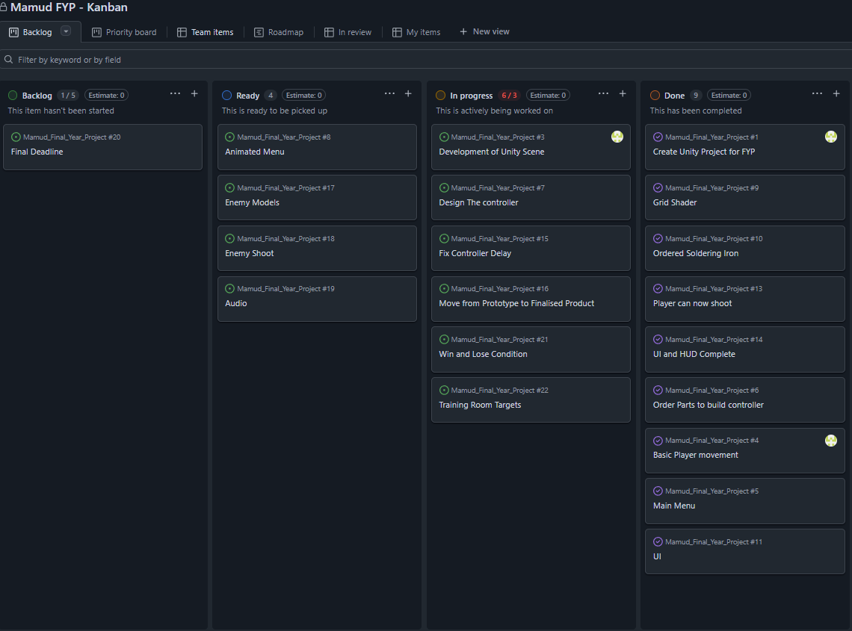
Kanban Planner

